Slide 1

Compilers Theory
Lab 3

Slide 2
Agenda
Thompson’s Construction – Review
Examples of NFAs Thompson’s Construction
Compiler Operation: Lexical Analysis
JASON Programming Language
Rynix Programming Language
Hands-on (JASON Scanner)

Slide 3
Quiz:
Next Week

Slide 4
Thompson's Construction

Slide 5
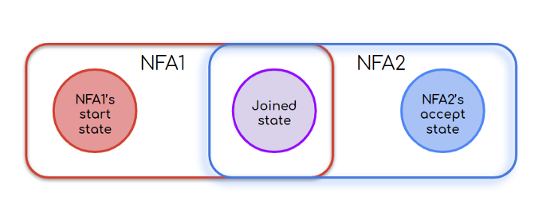
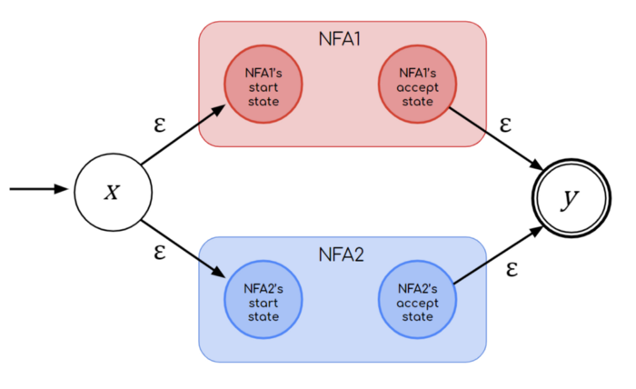
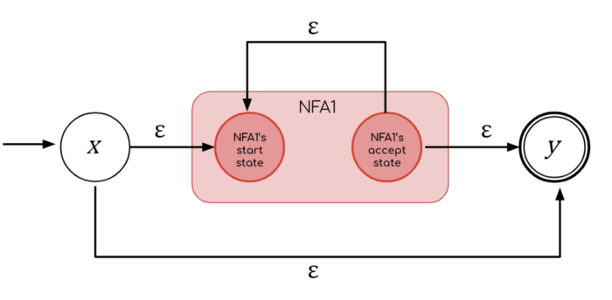
Thompson’s Construction - Review
Thompson Construction converts a regular expression into an NFA.
It uses ε-transitions to connect smaller NFAs.
Notes:
Notes: In Thompson construction:
You have one end state.
You cannot move back to the start state but start state can have transition to any state.

Slide 6
Examples Of NFAs
Thompson's Construction

Slide 7

In-class Exercise
Convert the following regular expression to an NFA using Thompson’s algorithm.
RE= (ab|c)*
Solution:
Step 1: construct NFA for r1
( a b | c)*
r1

Slide 8
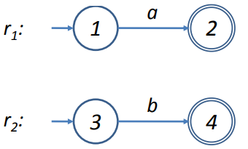
In-class Exercise (Cont.)
Step 2: construct NFA for r2
RE= ( a b | c )*
r1
r2

Slide 9

In-class Exercise (Cont.)
Step 3: construct NFA for r3
RE= ( ab | c )*
r3

Slide 10
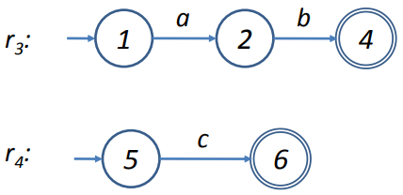
In-class Exercise (Cont.)
Step 4: construct NFA for r4
RE= ( ab | c )*
r3
r4

Slide 11
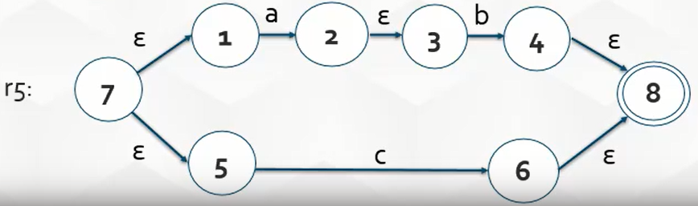
In-class Exercise (Cont.)
Step 5: construct NFA for r5
RE= ( ab|c )*
r5

Slide 12
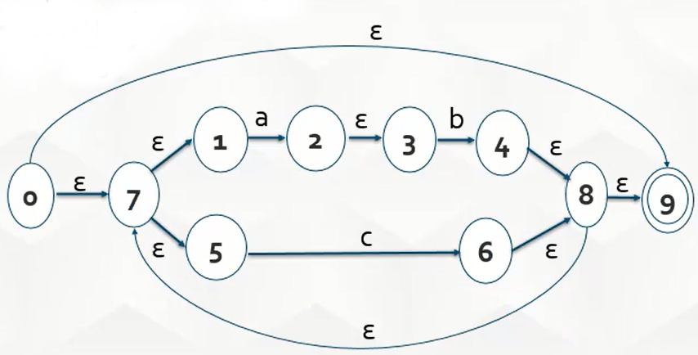
In-class Exercise (Cont.)
Step 6: construct NFA for r5*.
RE= (ab|c)*
R5*

Slide 13
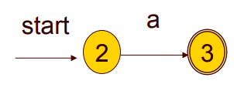
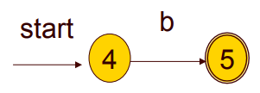
In-class Exercise (Cont.)
Convert the following regular expression to an NFA using Thompson’s algorithm.
RE= (a|b)*a
Solution:
N(r1) N(r2)
r1 | a
r2 | b
r3 | (a|b)
r4 | (a|b)*
r5 | a
r6 | (a|b)*a

Slide 14
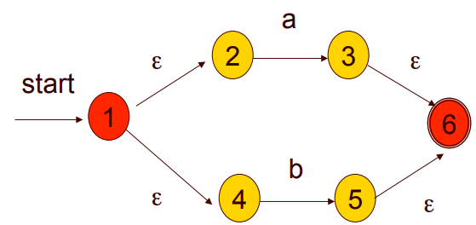
In-class Exercise (Cont.)
Step 3: N(r3)= N((a|b))
r1 | a
r2 | b
r3 | (a|b)
r4 | (a|b)*
r5 | a
r6 | (a|b)*a

Slide 15
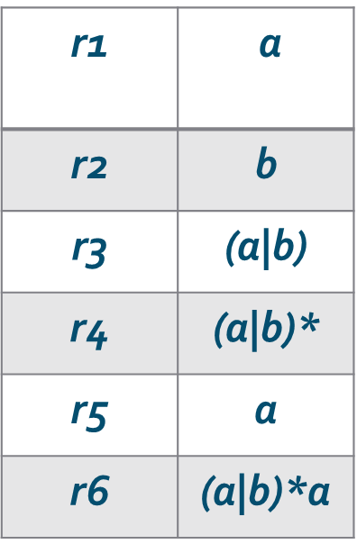
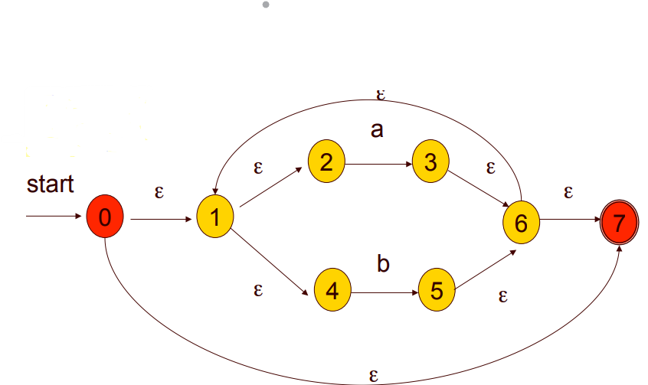
In-class Exercise (Cont.)
Step 4: N(r4)= N((a|b)*)

Slide 16
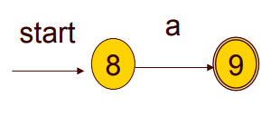
In-class Exercise (Cont.)
Step 5: N(r5)= N(a)

Slide 17
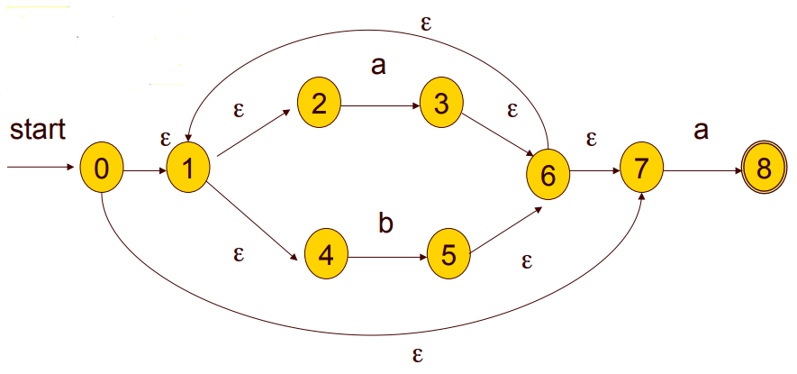
In-class Exercise (Cont.)
Step 6: N(r6)= N(r4r5)= N((a|b)*a)
8
9

Slide 18
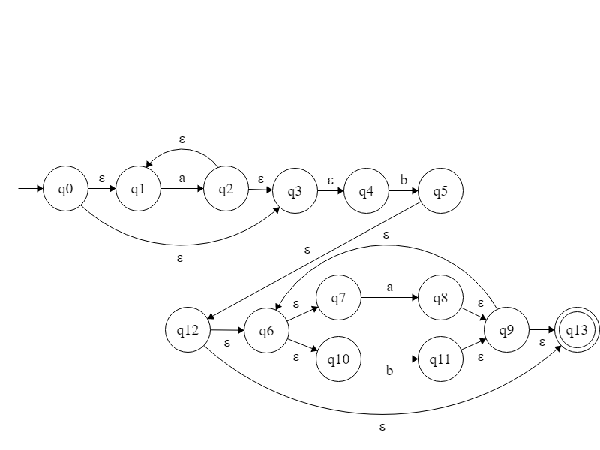
Self-Study Exercise
Using Thompson construction, create the NFA of the following regular expressions.
  RE = a*b(a|b)*

Slide 19
Compiler Operation: Lexical Analysis

Slide 20
COMPILER OPERATION: LEXICAL ANALYSIS
In the Lexical Analysis Phase, the compiler reads the actual source program and collects sequences of characters into meaningful units called tokens.
Basic Steps for building a scanner:
  Write down the RE for the input language
  Build an NFA for it
  Build the DFA that simulates the same NFA
  (Optional) Minimize the DFA
  Turn the DFA into code
Source Code
Stream of Tokens
Scanner

Slide 21
JASON Programming Language

Slide 22
JASON Programming Language
JASON stands for Just Another Simple Original Notion.
A limited purpose programming language designed to illustrate the principles of building compilers.
The basic syntax for a JASON program
PROGRAM programName;
Procedures, if any
DECLARE
DATATYPE IdList
….
BEGIN
Statement(s)
END.

Slide 23
JASON Programming Language cont.
Procedures have the following syntax:
PROCEDURE ProcName;
PARAMETERS
DataType Identifer;
…
Procedures, if any
DECLARE
Datatype IDList;
…
BEGIN
Statement(s)
END;

Slide 24
JASON Programming Language cont.
Language is case-insensitive
All Keywords are reserved (Shown in upper case for emphasis)
Parenthesis are not used in a CALL statement if no parameters are being passed.
JASON has 4 arithmetic operators (+,-,* and /) and 4 relational operators (=,>,<,!). The (!) is used to denote “is not equal to”
The entire operator set consists of one-character operators
Comments are enclosed in braces { }

Slide 25
JASON Programming Language cont.
JASON has seven valid types of statements:
  READ Identifier
  WRITE Identifier
  SET Identifier = Expression
  IF Condition THEN Statement(s) ELSE Statement(s) ENDIF
  WHILE Condition DO Statement(s) ENDWHILE
  UNTIL Condition DO Statement(s) ENDUNTIL
  CALL Identifier( ArgList )

Slide 26
Code Sample From Jason
BEGIN
WHILE x ! 0 DO
IF x < 0 THEN SET y=10 – 4.5*x;
ELSE SET y=4.5*x + 10;
ENDIF;
WRITE y;
READ x;
ENDWHILE;
END;
{ Main program }
BEGIN
READ a;
CALL FindFormula(a, b) ;
WRITE b;
END.
PROGRAM EvalFormula;
{Calculates the result of a basic formula
Illustrates the use of procedures in JASON}
DECLARE
INTEGER a;
REAL b;
{The procedure which evaluates the formula repeatedly}
PROCEDURE FindFormula;
PARAMETERS
INTEGER x;
REAL y;

Slide 27
The Token Classes In Jason
1) Keyword (each keyword is a distinct token)
The keywords of Jason are:
BEGIN | ENDIF | PARAMETERS | SET
CALL | ENDUNTIL | PROCEDURE | THEN
DECLARE | ENDWHILE | PROGRAM | UNTIL
DO | IF | READ | WHILE
ELSE | INTEGER | REAL | WRITE
END

Slide 28
The Token Classes In JASON cont.
2) Identifier
3) Constant
(numeric literal)
4) Operator (a single character):
  Operators have different types (DFA)
5) Delimiters
Letter ::= [A-Z]
Digit ::= [0-9]
Identifier ::= Letter ( Letter | Digit )*
Constant ::= Digit*( \. Digit⁺ )?
Operators ::= > | < | ! | = | + | - | * | /
Delimiters::= . | ; | , | ( | ) | { | }

Slide 29
Rynix Programming Language

Slide 30
Rynix Programming Language
The first task is to define a set of suitable regular expressions for Rynix rules.

Slide 31
Part(1): Rynix Programming Language
Milestone 1 Deliverables:
A document that consists of 3 sections:
  The Regular Expressions for Tokens only
  DFAs of Tokens only
  A copy of the implementation of the Scanner Code
The implementation of a fully scanner for the Rynix Language

Slide 32
Milestone (1) – Part 2:
Implement full Scanner for Rynix
1- Build DFAs needed to construct a Scanner for Rynix.
2- Implement a Full Scanner for Rynix programming Language.
Your interface should show:
  A Text area for typing in the Rynix code
  The Errors List
  Lexeme-to-Token Table.

Slide 33
Hands-on

Slide 34
Hands on - part 1:
Draw DFA for JASON (15 min)
Build the needed DFA(s) to construct a Scanner for JASON Programming Language.
Hints:
  Build DFA for identifier.
  Build DFA for constants.
  Build DFA for operators.
  Build DFA for Delimiters.
  Build DFA for Braces.
  Build DFA for Comment.
  Build DFA for reserved keywords.
You must handle all sigma and trap states as mentioned in the following slide.
It is not a mandatory to handle the entire sigma and the trap state

Slide 35
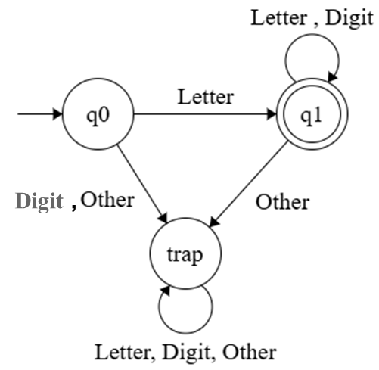
DFA Example for Identifier
∑ = [A-Z] [0-9] > < ! = + - * / . ; , { } ( )
DFA for the identifier
  Letter = [A-Z]
  Digit = [0-9]
  Other = > < ! = + - * / . ; , { } ( )

Slide 36
Task(1): Rynix Programming Language
Milestone 1 Deliverables:
A document that consists of 3 sections:
  The Regular Expressions for Tokens only
  DFAs of Tokens only
  A copy of the implementation of the Scanner Code
The implementation of a fully scanner for the Rynix Language

Slide 37
Hands on - part 2:
Implement Scanner for JASON (40 mins)
Implement a scanner for the JASON Language

Slide 38
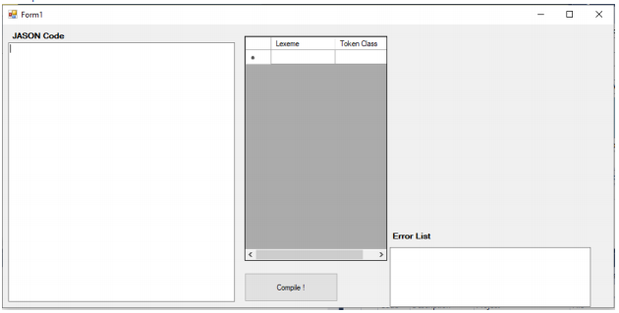
Hands on - part 2:
Implement Scanner for JASON (40 min)
User Interface:
  Text Area for code editing.
  A table that displays each Lexeme along with its Token Class.
  Error List. For unknown chars, wrong constants with multi dot, unclosed string constant, unclosed comment.
  A button to Compile.
Don’t forget to lowercase your JASON Code before scanning.

Slide 39
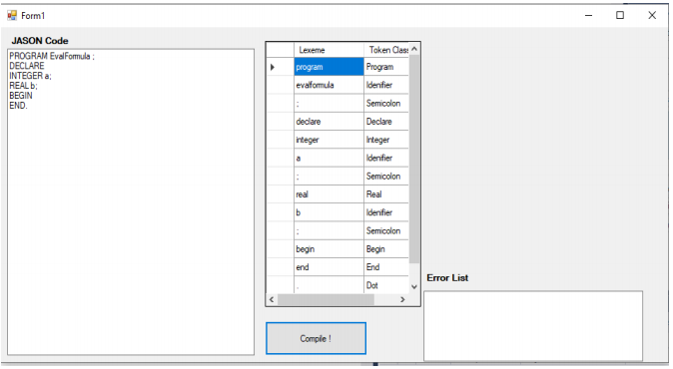
Hands on - part 2:
Implement Scanner for JASON
Sample Run:
JASON Code:
PROGRAM EvalFormula;
DECLARE
INTEGER a;
REAL b;
BEGIN
END.
Notes:
Template can be found at: shorturl.at/ilnvz

Slide 40
Questions?

